Slide 1
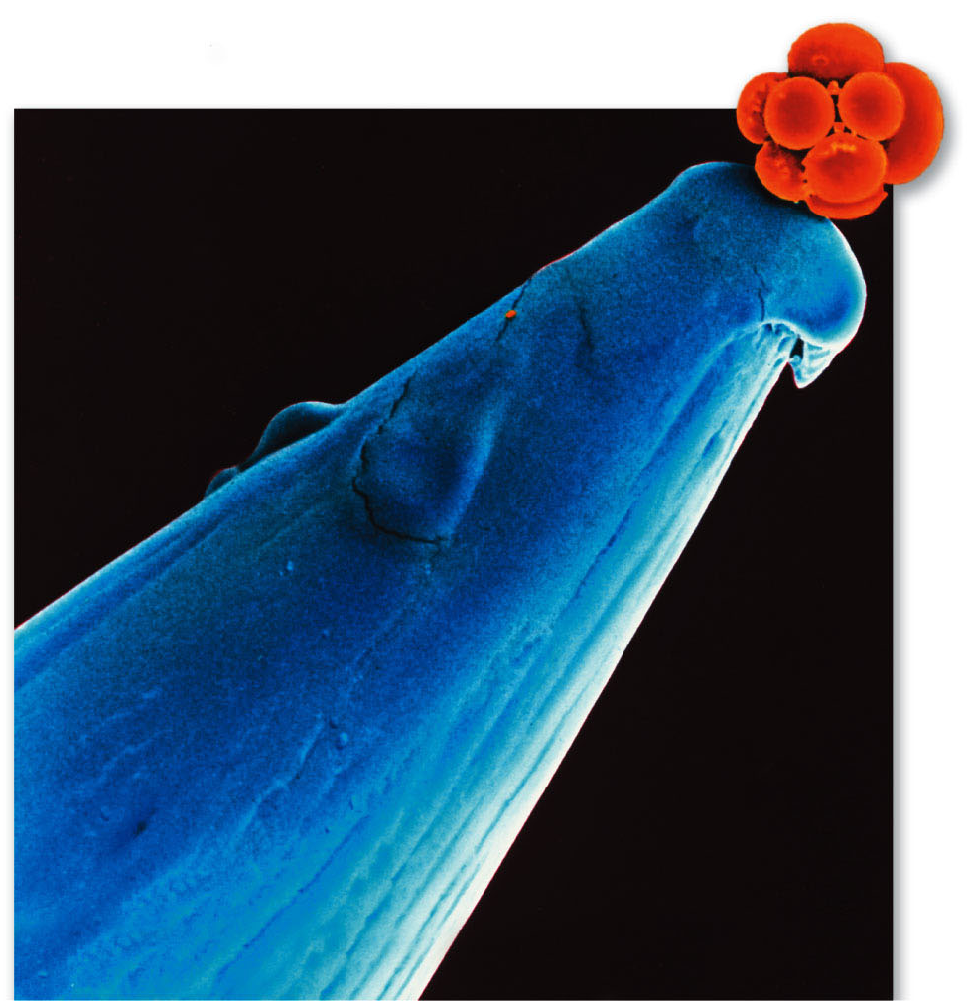
Intro to Biotech
Stem Cells/Regenerative Medicine
Lect.14
Development
egg
sperm
developmental stage
developmental capacity
Zygote
embryo
adult
Development
a. determination: acquisition of developmental fate
b. differentiation: expression of developmental fate
c. morphogenesis: development of form
d. growth: increase in size/volume

Slide 2
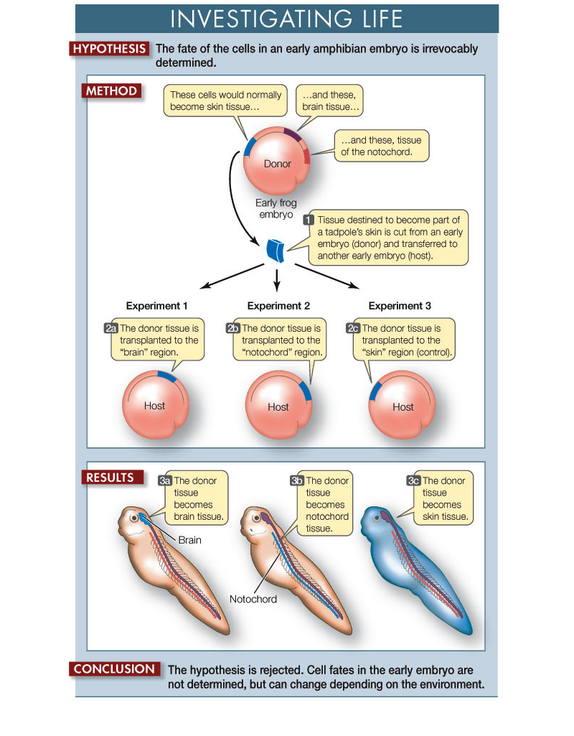
Intro to Biotech
Stem Cells/Regenerative Medicine
Lect.14
Determination can be context dependent

Slide 3
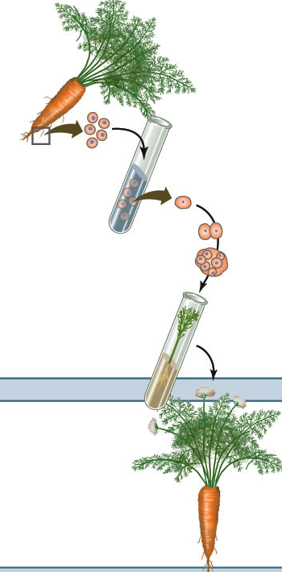
Intro to Biotech
Stem Cells/Regenerative Medicine
Lect.14
Developmental Potential – Plants
Differentiated
Culture leads
to dedifferentiation
callus formation
Embryo formation
Plant growth

Slide 4
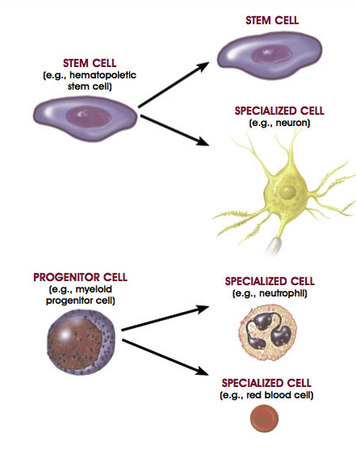
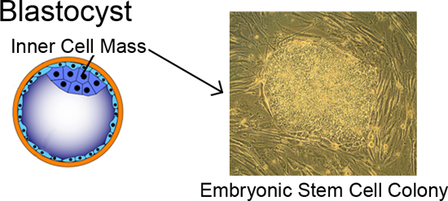
Intro to Biotech
Lect.14
Stem Cells/Regenerative Medicine
Developmental Potential – Animal cells
Stem Cell: undifferentiated, capable of continuous proliferation
Totipotent:
Pluripotent:
Multipotent:
Embryonic Stem Cells:
Adult Stem Cells:

Slide 5
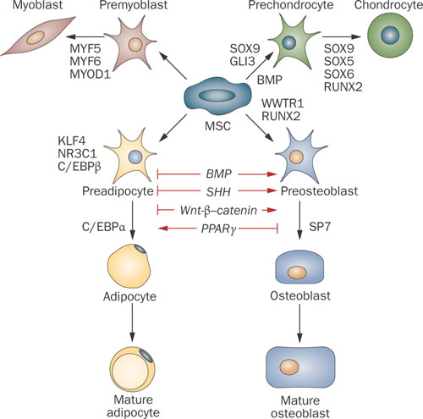
Intro to Biotech
Lect.14
Stem Cells/Regenerative Medicine
Developmental Potential – Animal cells
MSC
Specification of Developmental fates

Slide 6
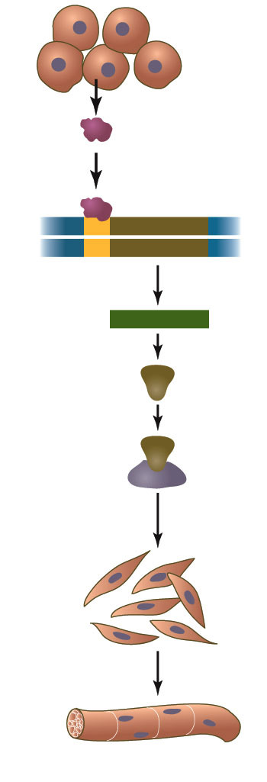
Intro to Biotech
Stem Cells/Regenerative Medicine
Lect.14
myoblast
MSC
developmental stage
developmental capacity
multipotent
Rb
E2F

Slide 7
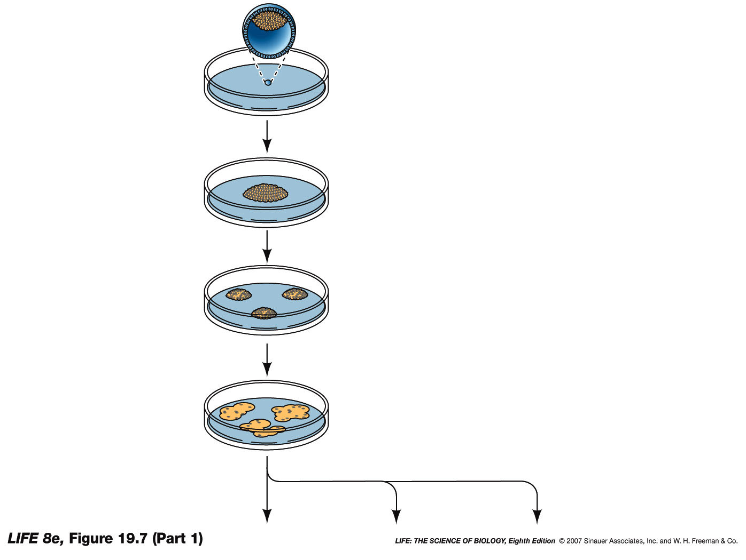
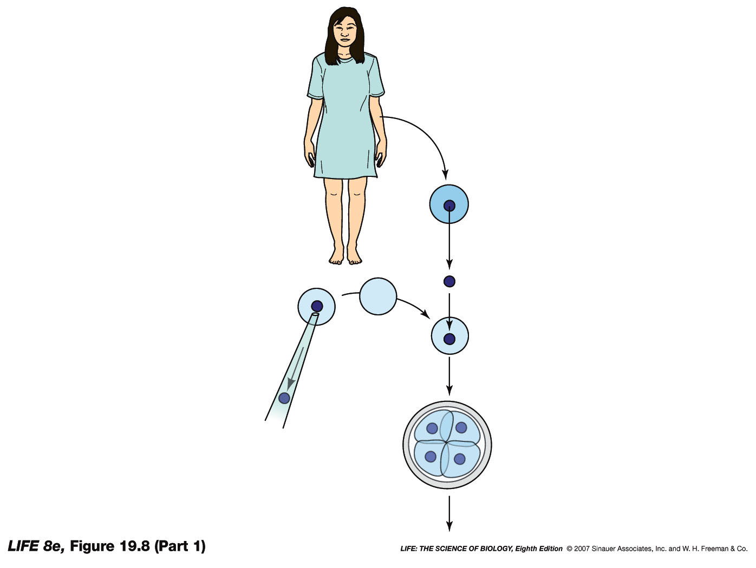
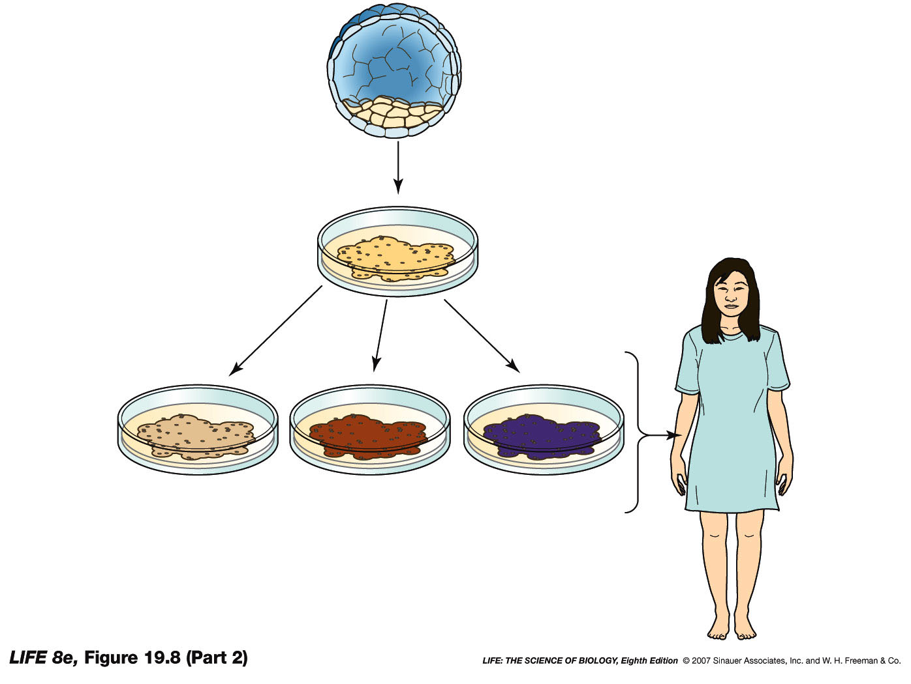
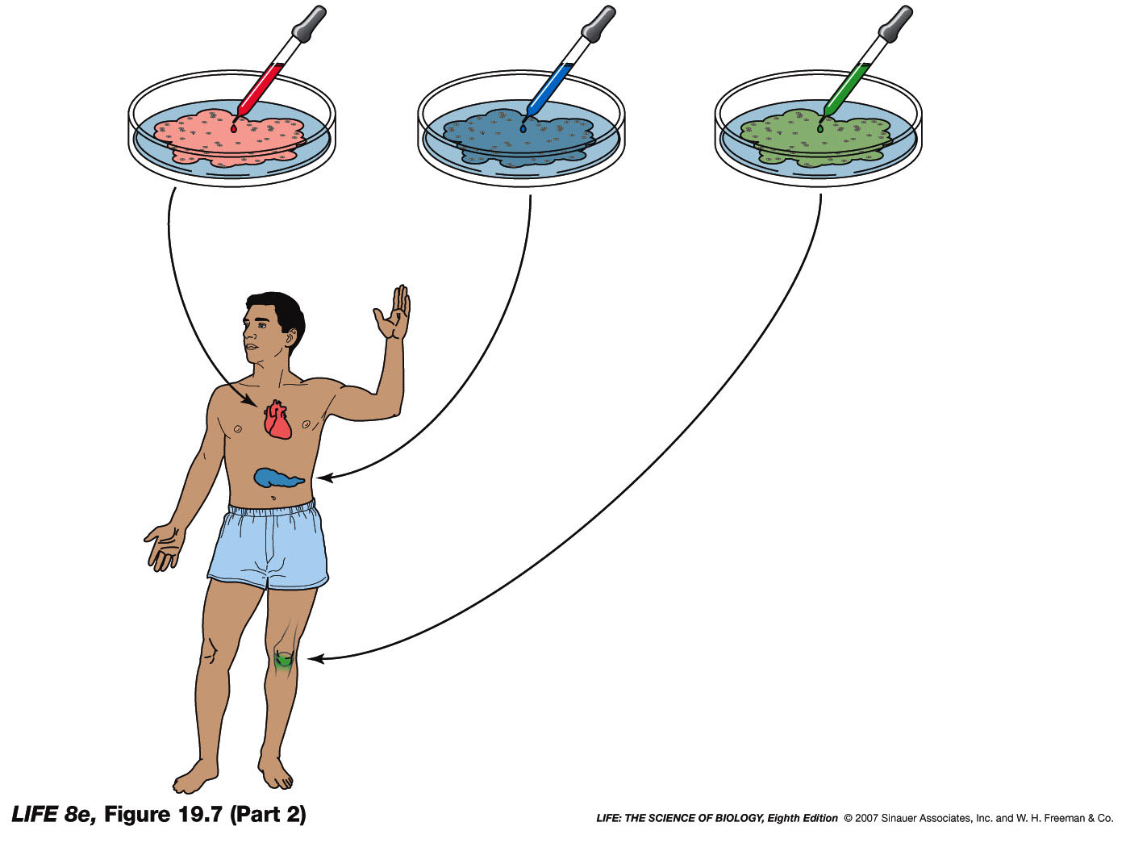
Intro to Biotech
Stem Cells/Regenerative Medicine
Lect.14
Developmental Potential – Animal cells
developmental capacity
Totipotent
Differentiated
embryonic
stem cells
bone
nerve
muscle
Adult stem cells: skin, intestine, blood…
Bone:
a.
b.

Slide 8
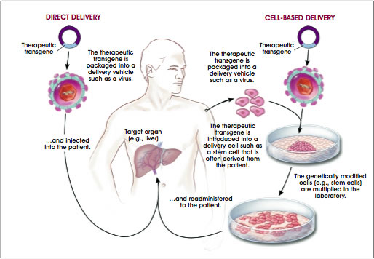
Intro to Biotech
Stem Cells/Regenerative Medicine
Lect.14
Gene Therapy – direct vs cell based

Slide 9
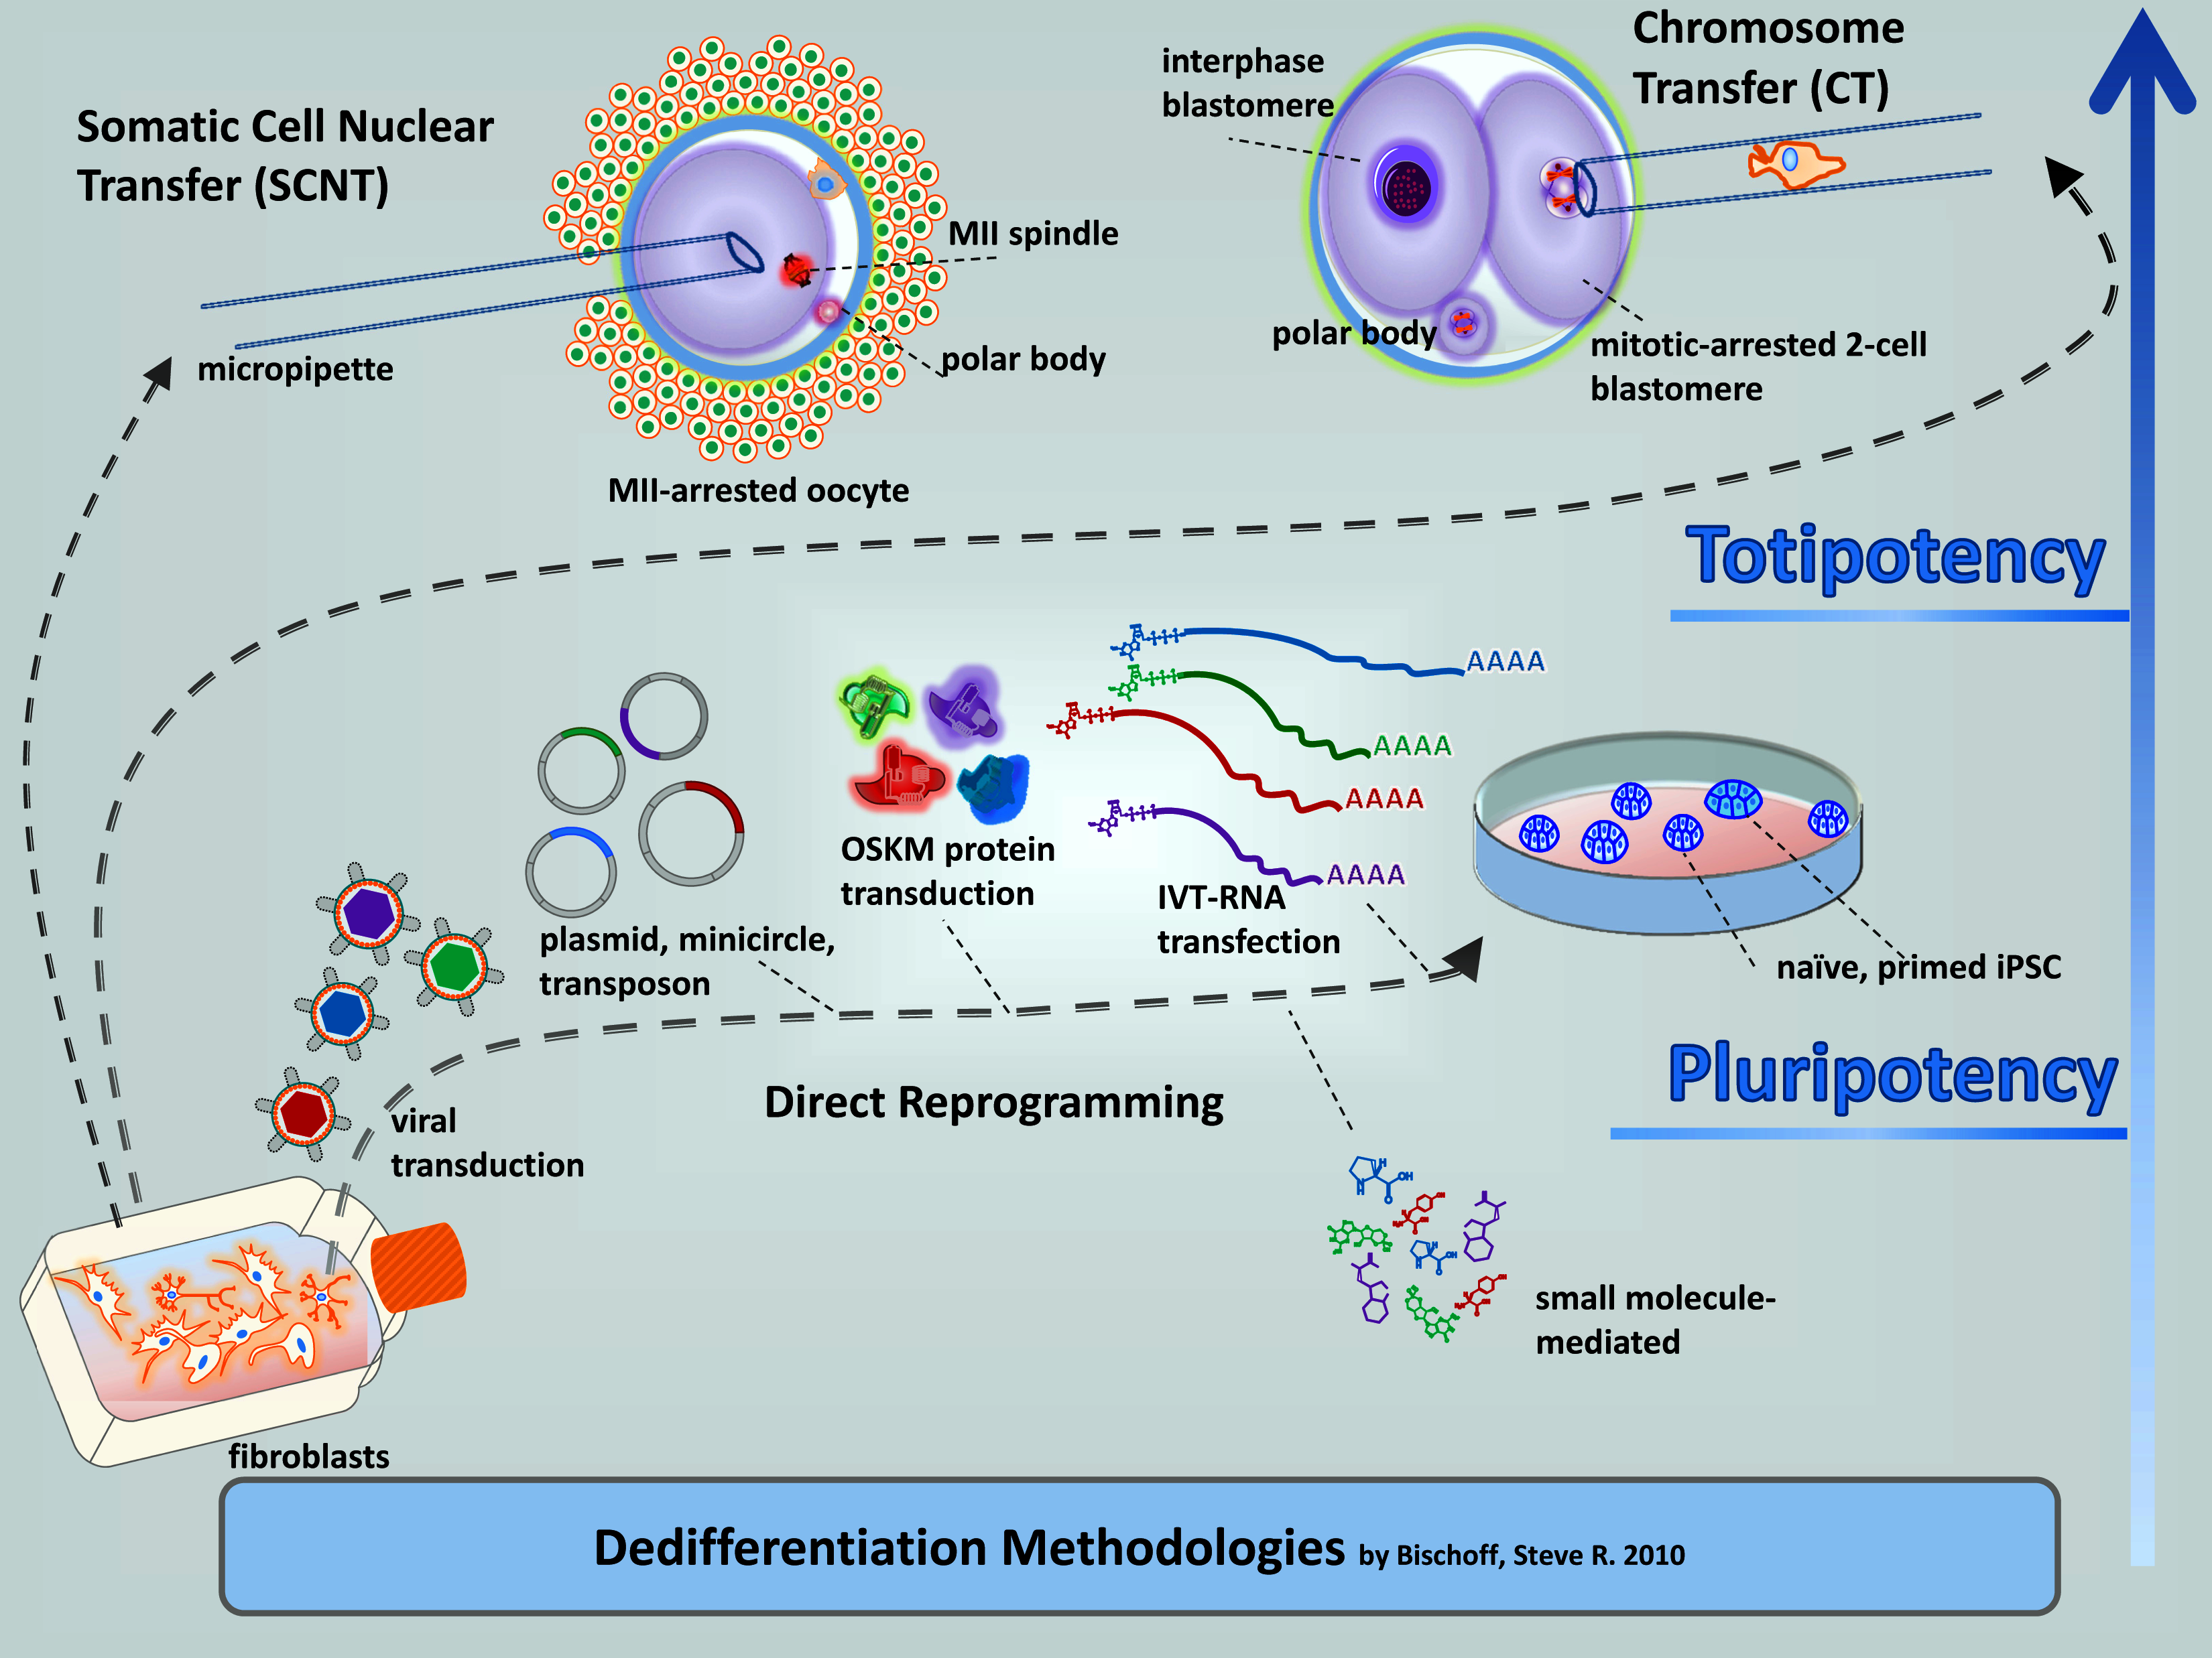
Intro to Biotech
Stem Cells/Regenerative Medicine
Lect.14
Gene Therapy – direct vs cell based
2006 - Induced Pluripotency! Yamanaka

Slide 10
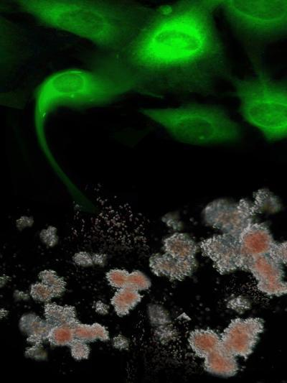
Intro to Biotech
Stem Cells/Regenerative Medicine
Lect.14
Totipotent vs Pluripotent
2006 - Induced Pluripotency! Yamanaka
Potential uses
• 2009 Fanconi anaemia
- Bone marrow failure (20% cancer)
- 13 genes (DNA repair)
- use fibroblast, repair defect
-
• Oct4, SOX2, KLF4, cMyc
• genetically corrected iPS cells
-
-
2.

Slide 11
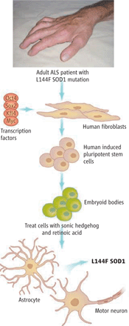
Intro to Biotech
Stem Cells/Regenerative Medicine
Lect.14
Totipotent vs Pluripotent
2006 - Induced Pluripotency! Yamanaka
OCT4, SOX2, KLF4, MYC
2008 - Eggan lab
Disease Research
•
•
•

Slide 12
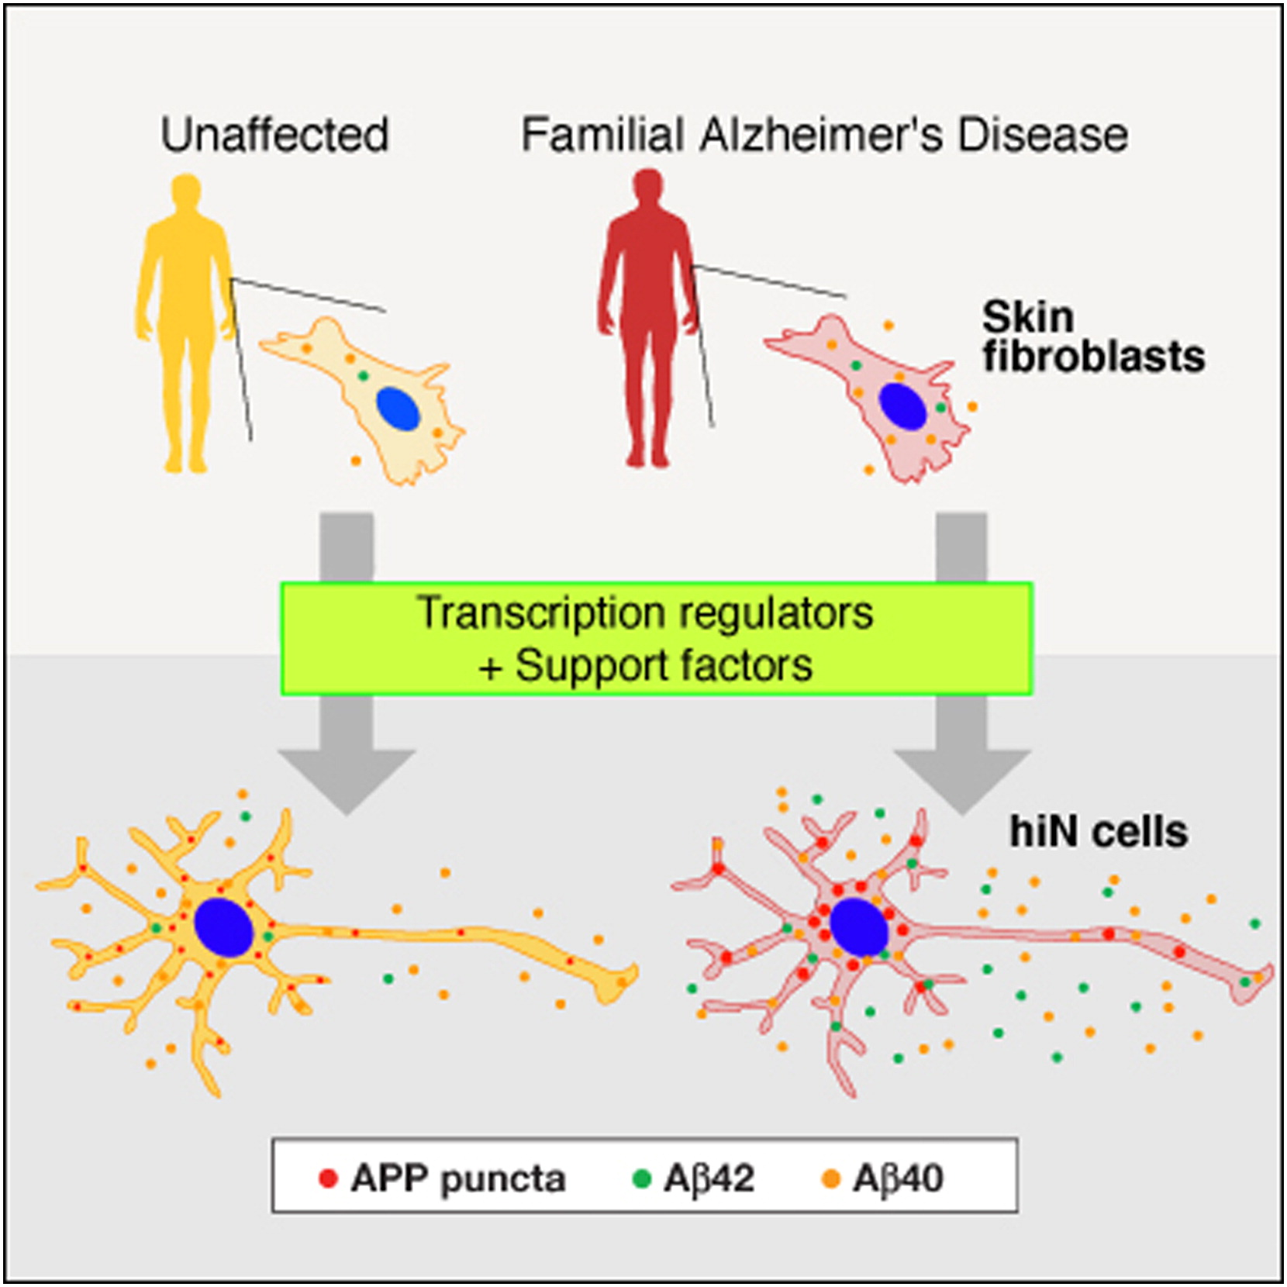
Intro to Biotech
Stem Cells/Regenerative Medicine
Lect.14
2008
2011
X

Slide 13
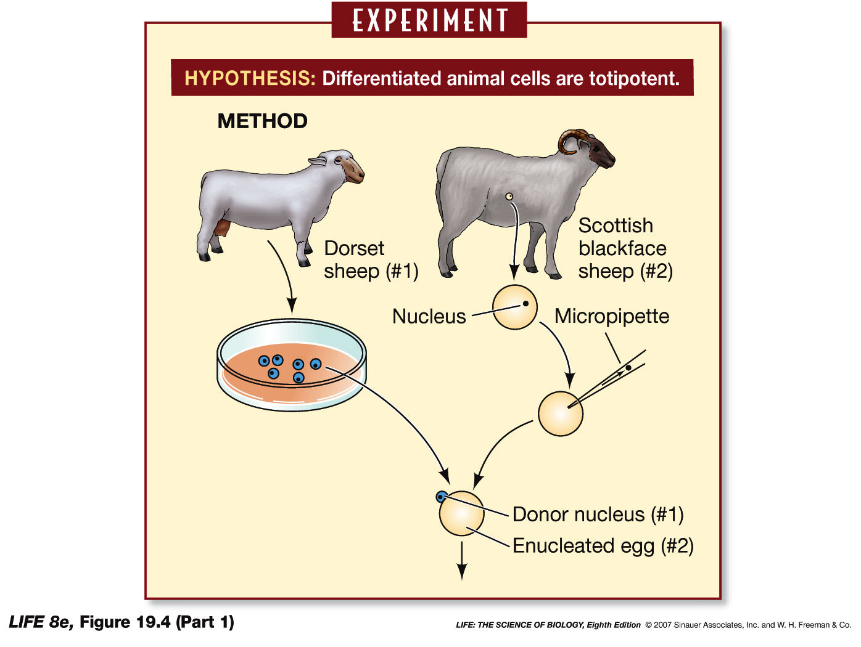
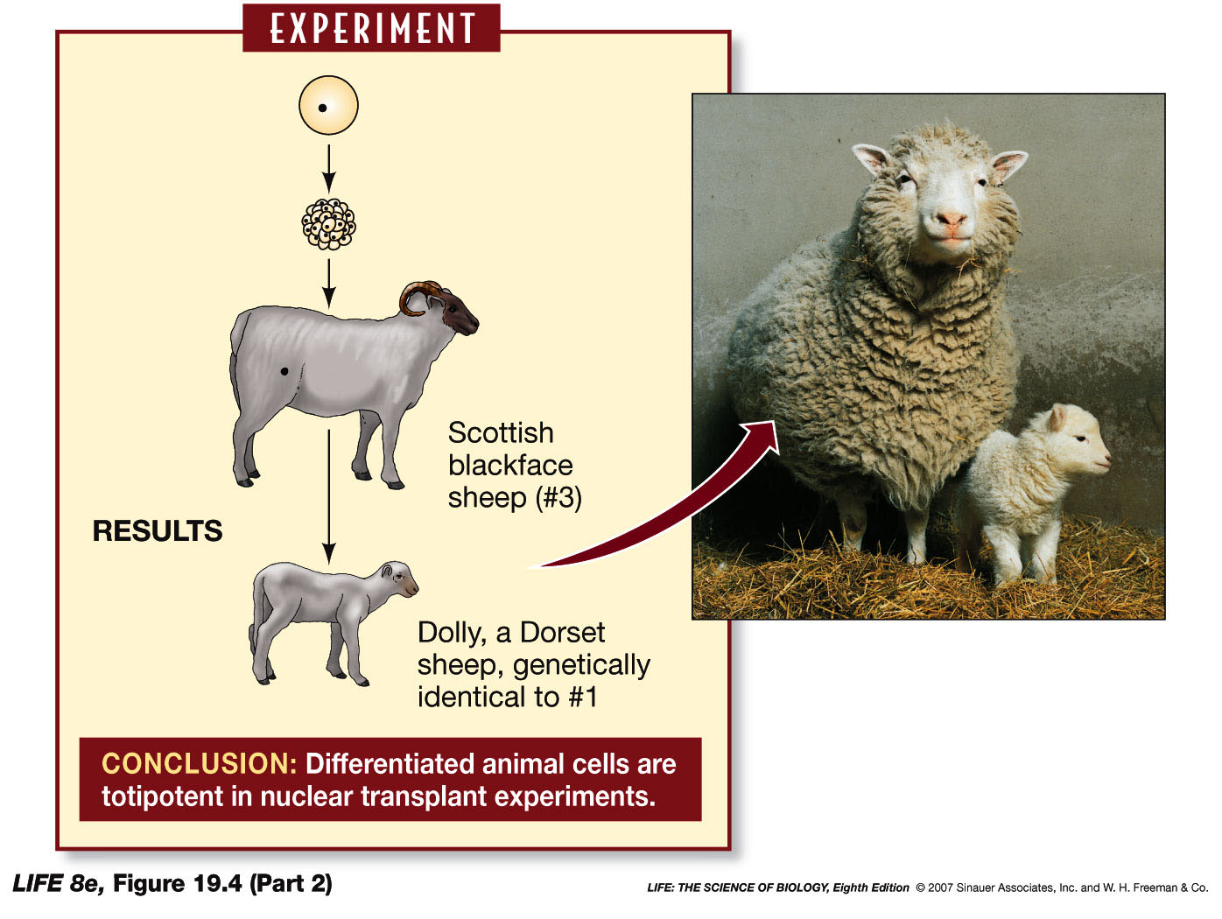
Intro to Biotech
Stem Cells/Regenerative Medicine
Lect.14
Totipotent - Cloning
somatic cells
G1 arrest
1.
a. sheep
b. goats
Mitotic inducers
2.
• Banteng (cow host)
• pandas (rabbit host)
Limitations:
• rejection
• material
• time frame
• ethics

